Slide 1




Project Human Resource Management

Slide 2

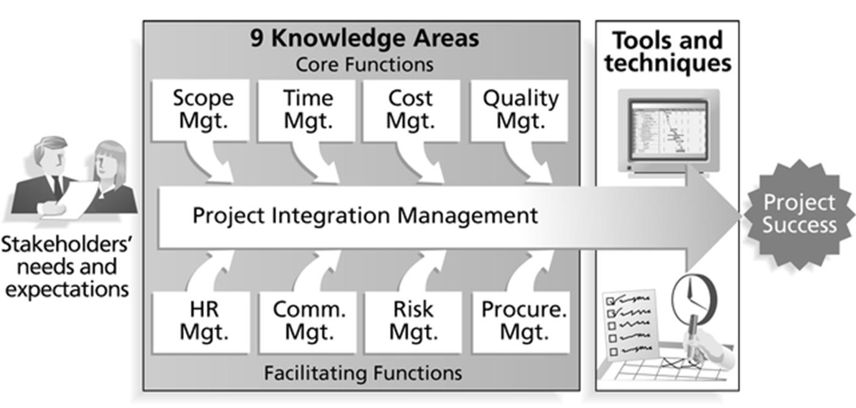
Human Resource Management
2

Slide 3



What is Project Human Resource Management?
◼Project human resource management is a subset of project
management that includes the processes required to make
the most effective use of the people involved within a project.
◼Processes include
1)
Organizational planning
2)
Staff acquisition
3)
Team development
3

Slide 4
Keys to Managing People
◼Important areas related to project human resource
management include
◼Motivation
◼Influence and Power
◼Effectiveness
4

Slide 5
Motivation
◼Abraham Maslow developed a hierarchy of needs to illustrate
his theory that people’s behaviors are guided by a sequence of
needs
◼Maslow argued that human beings possess unique qualities that
enable them to make independent choices, thus giving them
control of their destiny
5

Slide 6

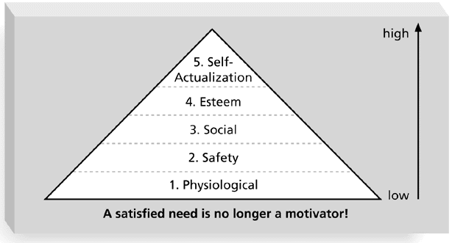
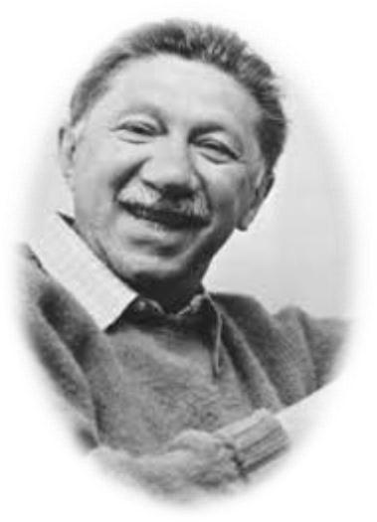
Maslow’s Hierarchy of Needs
6

Slide 7
Herzberg’s Motivational and Hygiene Factors
◼Frederick Herzberg wrote several famous books and articles
about worker motivation. He distinguished between
◼Motivational factors: achievement, recognition, the work
itself, responsibility, advancement, and growth, which
produce job satisfaction
◼Hygiene factors: cause dissatisfaction if not present, but
do not motivate workers to do more. Examples include
larger salaries, more supervision, and a more attractive work
environment
7

Slide 8
McGregor’s Theory X and Y
◼
Douglas McGregor popularized the human relations approach to management in the 1960s
◼
Theory X
: assumes workers dislike and avoid work, so managers must use coercion,
threats and various control schemes to get workers to meet objectives
◼
Theory Y
: assumes individuals consider work as natural as play or rest and enjoy the
satisfaction of esteem and self-actualization needs
◼
Theory Z
: introduced in 1981 by William
Ouchi
and is based on the Japanese approach to
motivating workers, emphasizing trust, quality, collective decision making, and cultural
values
8

Slide 9
Ways to Influence that Help and Hurt Projects
◼Projects are more likely to succeed when project
managers influence with
◼expertise
◼work challenge
◼Projects are more likely to fail when project
managers rely too heavily on
◼authority
◼money
◼penalty
9

Slide 10
Power
◼Power is the potential ability to influence behavior to get people
to do things they would not otherwise do
◼Types of power include:
• Coercive
• The ability of a manager to force an employee to follow an order by
threatening the employee with punishment if the employee does not
comply with the order
• Legitimate
• It is based on the reality that a person holds a particular position in an
organization. It's also based on the perception of an employee that
someone holding that position has authority to exert control over her.
10

Slide 11
• Expert
• A power based upon employees' perception that a manager or some other
member of an organization has a high level of knowledge or a specialized
set of skills that other employees or members of the organization do not
possess
• Reward
• Power that arises from the ability of a person to influence the allocation of
incentives in an organization. These incentives include salary increments,
positive appraisals and promotions.
• Referent
• It arises from interpersonal relationships that a person cultivates with other
people in the organization. People possess reference power when others
respect and like them. Referent power arises from charisma, as the
charismatic person influences others via the admiration, respect and trust
others have for her.

Slide 12
Improving Effectiveness - Covey’s 7 Habits
◼Project managers can apply Covey’s 7 habits
to improve
effectiveness on projects
Be proactive
1)
2)
Begin with the end in mind
3)
Put first things first
Think win/win
4)
5)
Seek first to understand, then to be understood
6)
Synergize
7)
Sharpen the saw
12

Slide 13
Empathic Listening and Rapport
◼Good project managers are empathic listeners; they listen with the
intent to understand
◼Before you can communicate with others, you have to have rapport
◼Mirroring is a technique to help establish rapport
◼Software professionals often need to develop empathic listening and
other people skills to improve relationships with users and other
stakeholders
13

Slide 14
Improving Relationships Between Users and Developers
◼Some organizations require business people, not IT people, to take the
lead in determining and justifying investments in new computer
systems
◼CEOs push their staff to recognize that the needs of the business must
drive all technology decisions
◼Some companies reshape their IT units to look and perform like
consulting firms
14

Slide 15
Organizational Planning
◼Organizational planning involves identifying, documenting and
assigning project roles, responsibilities and reporting relationships
◼Outputs and processes include
◼project organizational charts
◼work definition and assignment process
◼responsibility assignment matrixes
◼resource histograms
15

Slide 16

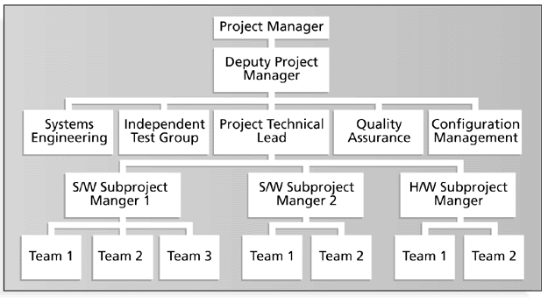
SAMPLE ORGANIZATIONAL CHART FOR A
LARGE IT PROJECT
16

Slide 17

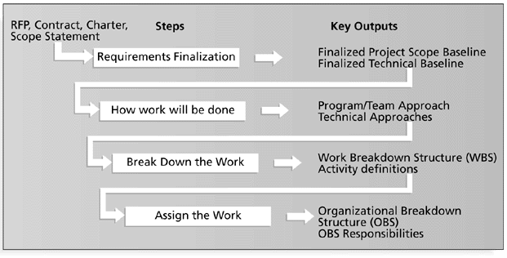
Work Definition and Assignment Process
17

Slide 18

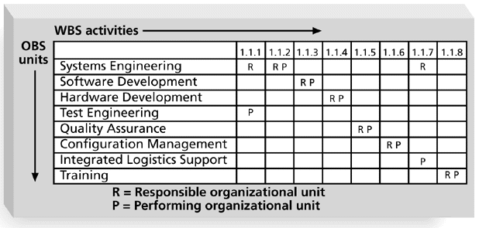
Sample Responsibility Assignment Matrix (RAM)
18

Slide 19

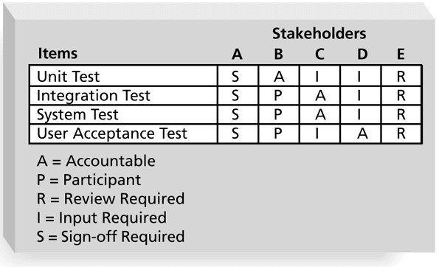
RAM Showing Stakeholder Roles
19

Slide 20
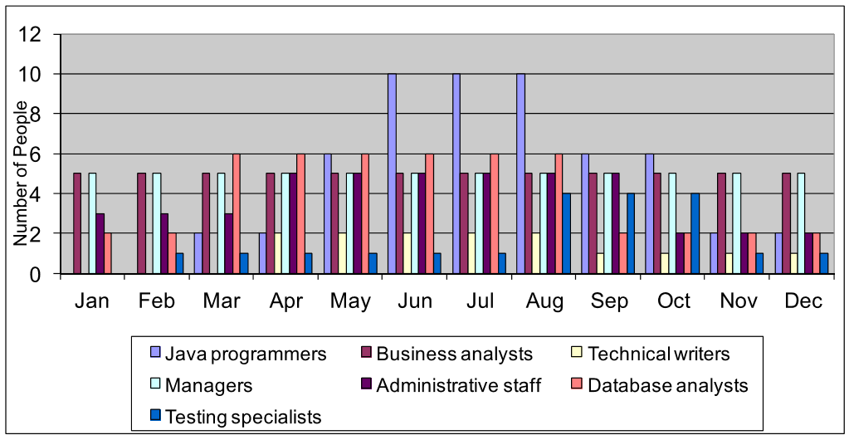
Sample Resource Histogram for a Large IT Project
20

Slide 21
STAFF ACQUISITION
◼Staffing plans and good hiring procedures are important in staff
acquisition, as are incentives for recruiting and retention
◼Some companies give their employees one dollar for every hour a
new person they helped
◼Some organizations allow people to work from home as an
incentive
◼Research shows that people leave their jobs because they don’t
make a difference, don’t get proper recognition, aren’t learning
money
21

Slide 22
Resource Loading and Leveling
◼Resource loading refers to the amount of individual
resources an existing project schedule requires during
specific time periods
◼Resource histograms show resource loading
◼Over-allocation means more resources than are available
are assigned to perform work at a given time
22

Slide 23

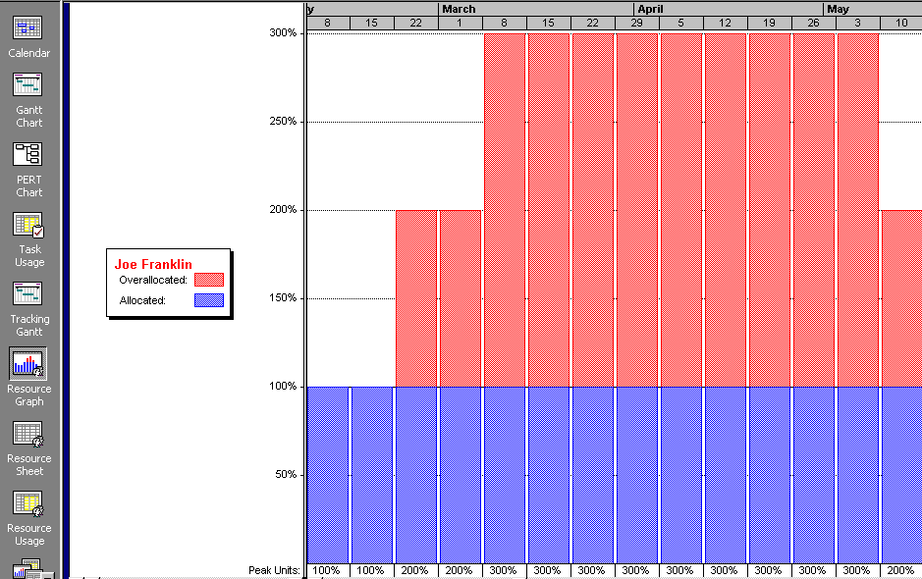
Sample Histogram Showing an Over-
allocated Individual
23

Slide 24
Resource Leveling
◼Resource leveling is a technique for resolving
resource conflicts by delaying tasks
◼The main purpose of resource leveling is to create a
smoother distribution of resource usage and reduce
over-allocation
24

Slide 25
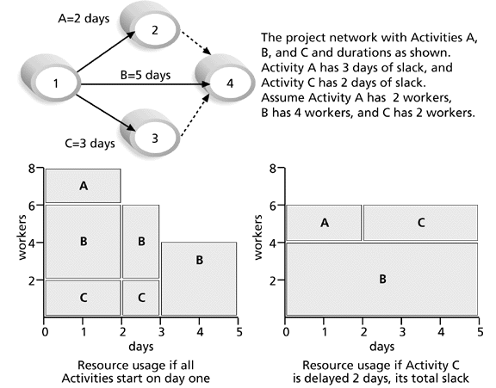
RESOURCE LEVELING EXAMPLE
25

Slide 26
Team Development
◼It takes teamwork to successfully complete most projects
◼Training can help people understand themselves, each
other, and how to work better in teams
◼Team building activities include
◼physical challenges
◼psychological preference indicator tools
26

Slide 27
MEYERS-BRIGGS TYPE INDICATOR (MBTI)
1.
Favorite World:
Do you prefer to
focus on the outer world or your own inner world
? This
is called Extraversion
(E) or Introversion
(I)
2.
Information:
Do you prefer to
focus on the basic information you take in
or
do you prefer
to interrupt and add meaning? This is called Sensing
(S) or Intuition
(N)
3.
Decisions:
When making decisions, do you prefer to first look at
logic and consistency
or
first look at the people and special circumstances? This is called Thinking
(T) or Feeling
(F)
4.
Structure:
In dealing with the outside world, do you prefer to
get things decided
or do
you prefer to stay open to new information and options? This is called Judging
(J) or
Perceiving
(P)

Slide 28
MEYERS-BRIGGS TYPE INDICATOR (MBTI)
◼
MBTI is a popular tool for determining personality preferences and helping teammates
understand each other
◼
Four dimensions of MBTI include:
Reading Assignment 1
◼
Extrovert/Introvert (E/I)
◼
Sensation/Intuition (S/N)
◼
Thinking/Feeling (T/F)
◼
Judgment/Perception (J/P)
◼
NTs or rational are attracted to technology fields
◼
IT people vary most from the general population in not being extroverted or sensing
28

Slide 29
Social Styles Profile
◼People are perceived as behaving primarily in one of four
zones, based on their assertiveness and responsiveness:
◼Drivers
Reading Assignment 2
◼Expressives
◼Analyticals
◼Amiables
◼People on opposite corners (drivers and amiables, analyticals
and expressives) may have difficulties getting along
29

Slide 30

Social Style Types
Responsiveness (Sociability) = degree to which a person:
High
- Makes his/her opinions known
- Tries to control/influence others
- Speaks out/makes statements
Amiable
Expressive
Assertiveness (Dominance) = degree to which a person:
Low
High
- Expresses his/her emotions
Analytical
Driver
- Enjoys interacting with others
Low
30

Slide 31
Reward and Recognition Systems
◼Team-based reward and recognition systems can promote
teamwork
◼Focus on rewarding teams for achieving specific goals
◼Allow time for team members to mentor and help each
other to meet project goals and develop human resources
31

Slide 32
General Advice on Teams
◼Focus on meeting project objectives and producing positive results
◼Fix the problem instead of blaming people
◼Establish regular, effective meetings
◼Nurture team members and encourage them to help each other
◼Acknowledge individual and group accomplishments
32

Slide 33
Using Software to Assist in Human Resource Management
◼Software can help in producing RAMs and resource
histograms
◼Project management software includes several features
related to human resource management such as
◼viewing resource usage information
◼identifying under and over allocated resources
◼leveling resources
33

Slide 34

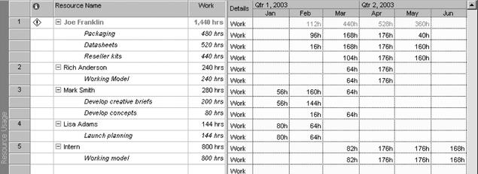
Resource Usage View from Microsoft
Project
34

Slide 35

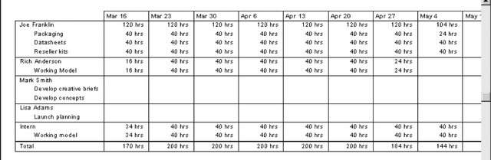
Resource Usage Report from Microsoft
Project

Slide 36
Project Resource Management Involves Much
More Than Using Software
◼Project managers must
◼Treat people with consideration and respect
◼Understand what motivates them
◼Communicate carefully with them
◼Focus on your goal of enabling project team
members to deliver their best work
36

Slide 37

Thank
you

